Slide 1



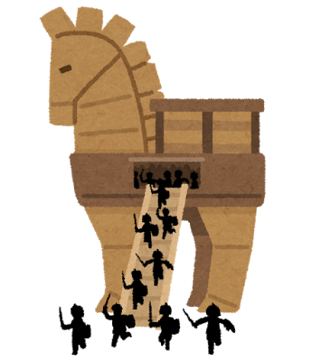
FPGA Reliability and Security
Ahmed Foisal, Mian Riaz-ul-Haque, Islam Syful and Michihiro Shintani
Dependable System laboratory, Graduate School of Information Science,
Nara Institute of Science and Technology (NAIST)
Background
FPGA is a modern reconfigurable platform
Recent concerned issues are Reliability and Security due to
Counterfeiting
Hardware Trojan (HT)
Motivation
Detect the Counterfeit FPGA and HT
Protect the critical applications(i.e. medical,
nuclear plant, defence etc. ) from catastrophic
conditions.
Manufacturers
Retailers
Users
Attackers
Counterfeiting
HT

Slide 2
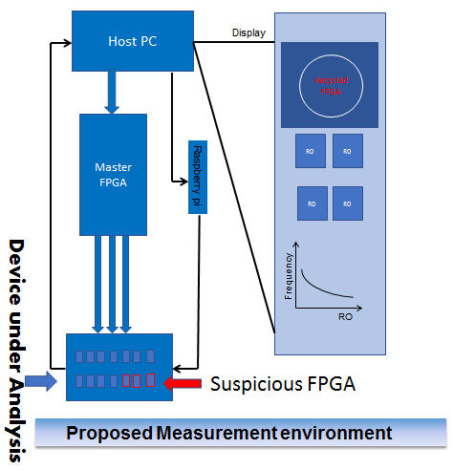
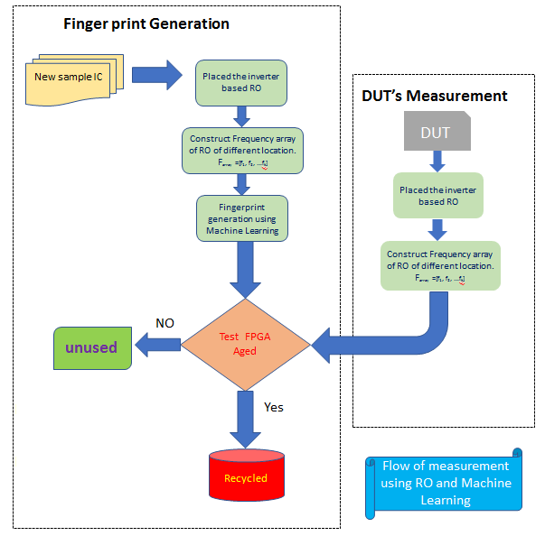
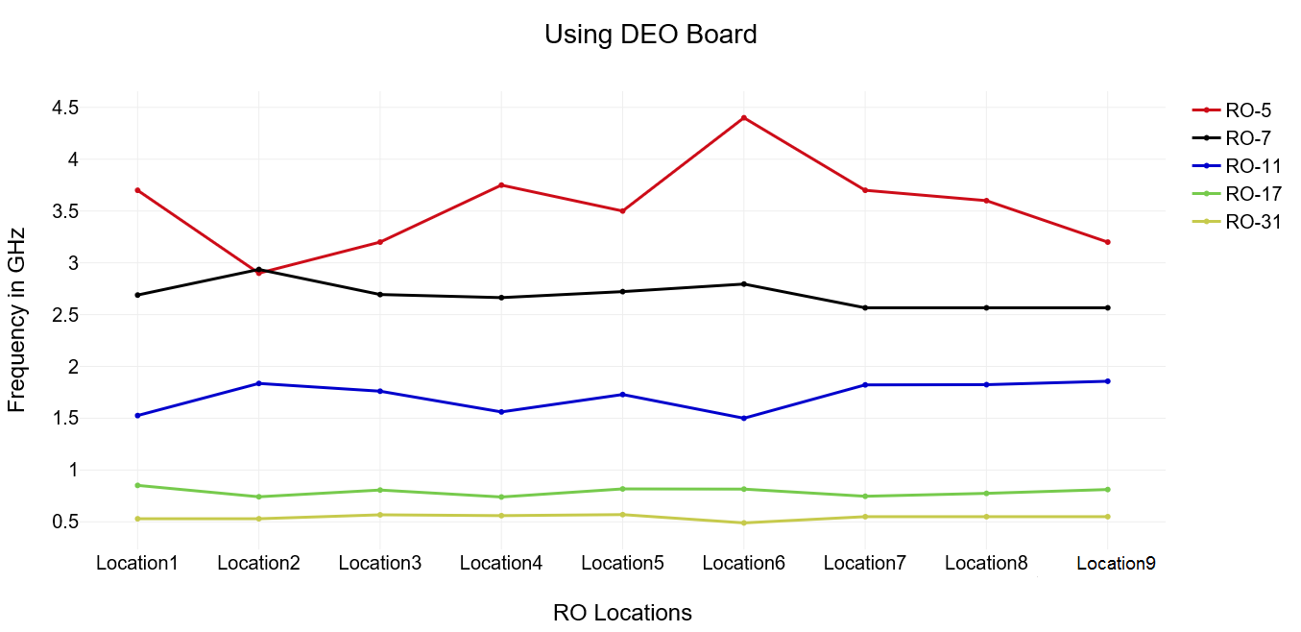
Proposed FPGA System
Hardware Part
Ring Oscillator based
Host PC controls all FPGA’s
Monitor display the result
Software Part
Finger Print Generation
Using Golden FPGA
Frequency from different ROs
Applying Machine Learning Algorithm
DUT’s Measurement
Using Suspicious FPGA
Applying same technique
Compare result with Golden data for decision.
Hardware Part
Software Part
Result

